Slide 1
MWD 2.01 Vocab

Slide 2
Graphics
anything on the page that is not actual text, from simple line drawings to fully active images found on the World Wide Web.

Slide 3
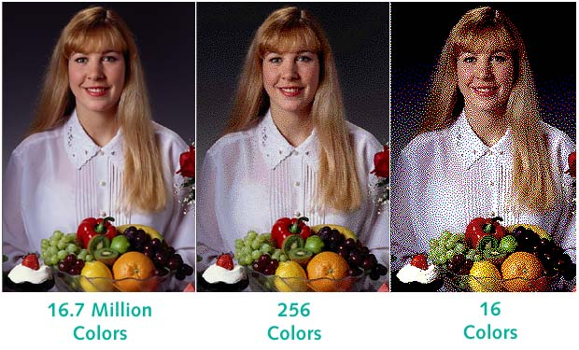
Color Depth
The number of colors per pixel that can be contained in an image.

Slide 4
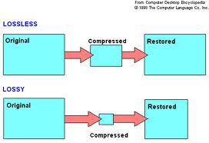
Compression
how an image is saved in order to reduce the file size.

Slide 5
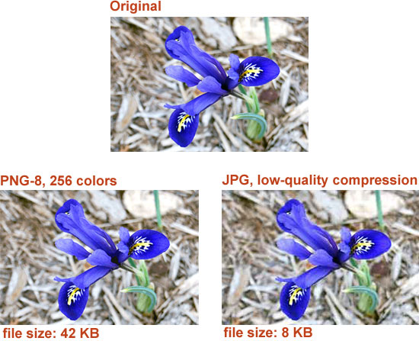
Lossless
Reduces the file size without losing any pixel data
Quality is not compromised

Slide 6
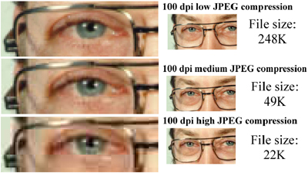
Lossy
Alters and/or eliminates some data
The more the image is reduced, the more the quality is degraded

Slide 7
Portability
How easily you can open, modify, and view the files on computers using different operating systems, software and browsers.

Slide 8
Transparency
Allows the background color of an image to be “eliminated” or made transparent so that the background behind the image can be seen.

Slide 9
Cloning
Copying part of an image and using it to replace unwanted parts of the image.

Slide 10
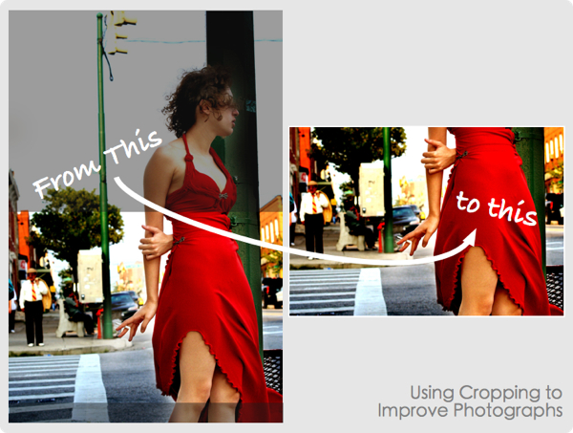
Cropping
Cutting out part of an image, original image retains same file size, and the cut image can be saved as new object.

Slide 11
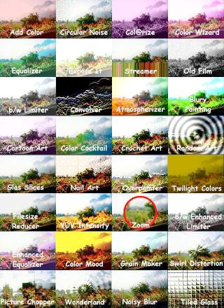
Filters
Used to apply special effects to an image that would be too difficult to create manually.

Slide 12
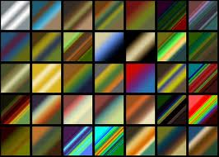
Gradient
Filling an object/image with a smooth transition from one color to another.

Slide 13
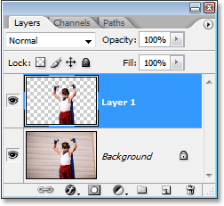
Layers
Compiling multiple pictures or objects together into one image

Slide 14
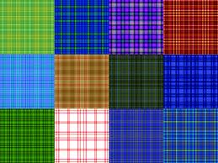
Patterns
raster graphics used to fill an object or selection

Slide 15
Textures
used to create filters and backgrounds

Slide 16
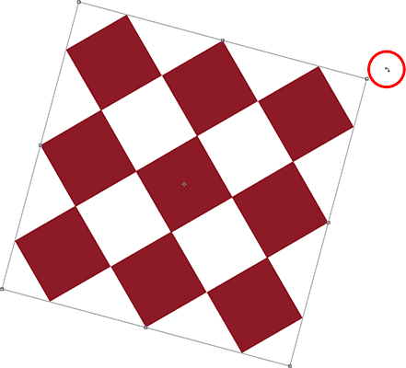
Rotating
Pivoting an object around its center point

Slide 17
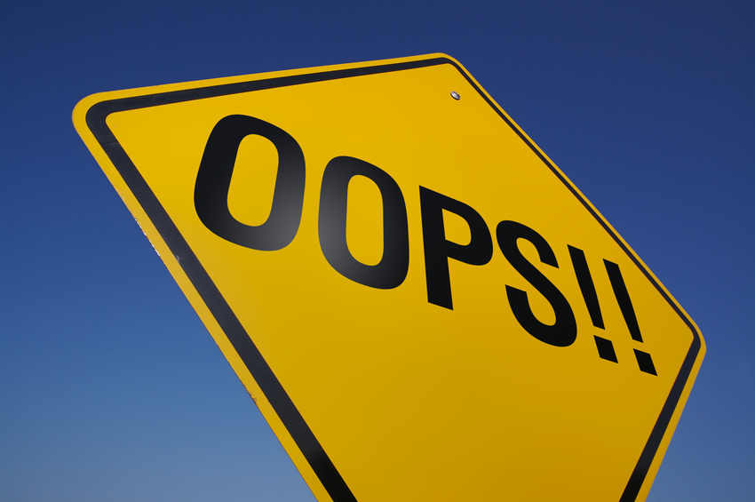
Clip Art
premade graphics that are available online and in many software packages; may be vector or raster.

Slide 18
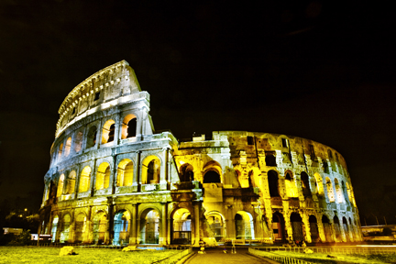
Photographs
raster images that contain millions of colors.

Slide 19
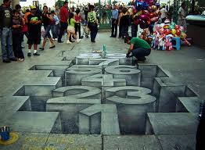
Art Work
computer created drawings or paintings; may be raster or vector.

Slide 20
Resolution
is the amount of detail (or data) stored for an image.

Slide 21
Aspect Ratio
relationship of an object’s width to its height

Slide 22
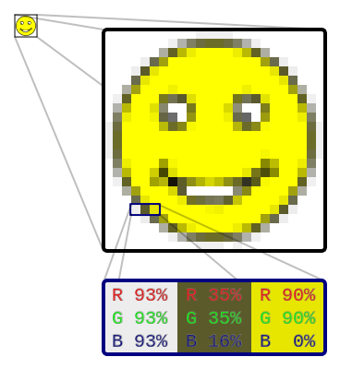
Raster Graphics
Also called bitmap graphics, consist of grids of tiny dots called pixels.

Slide 23
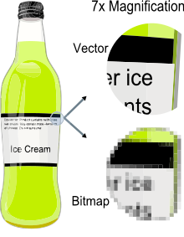
Vector Graphics
Vector graphics are created from mathematical formulas used to define lines, shapes and curves.

Slide 24
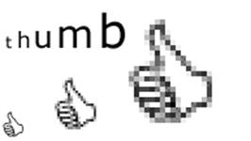
Meta Graphics
Can contain vector and raster data.

