Slide 1
Reading labels 5.02

Slide 2
Consumer information for medical drug products

Slide 3
prescription drug
Medicine available only by written order from a doctor

Slide 4

over-the-counter drug
Medicine available without a written order from a doctor

Slide 5
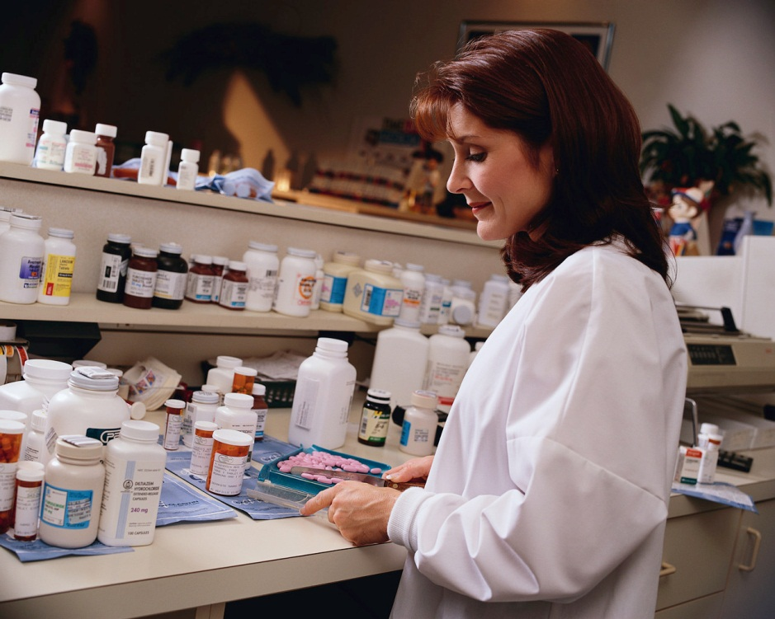
Pharmacist
A person licensed to sell prescription drugs with written order from a doctor

Slide 6
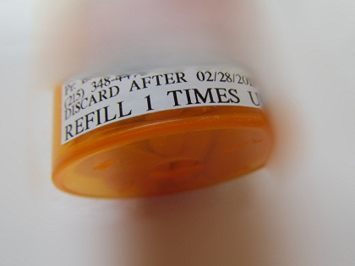
expiration date
Date after which a medicinal drug is no longer safe and effective to use

Slide 7
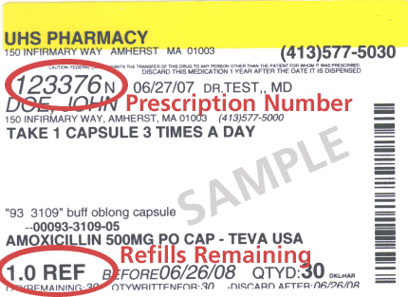
Renewable
A prescription that allows a consumer to purchase refills

Slide 8
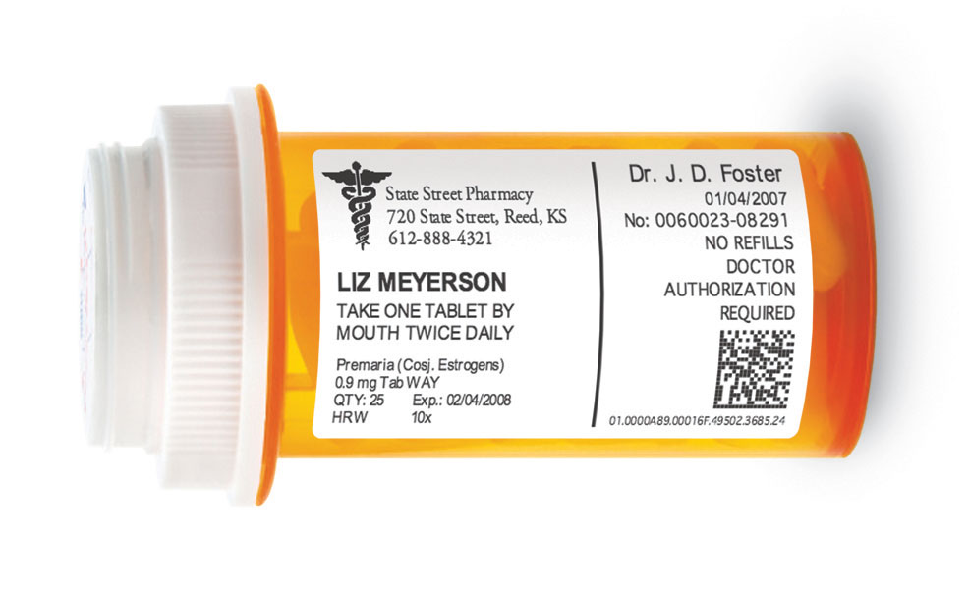
Dosage
Amount and frequency of a medicinal drug that may be taken safely

Slide 9
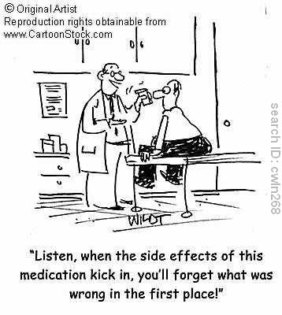
side effect
Other physical conditions, usually unwanted, that result from taking a medicinal drug---e.g., nausea, headache, diarrhea

Slide 10
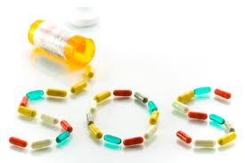
interaction with other medicines
Side effects that result from having two or more medicinal drugs in the body at one time

Slide 11
habit-forming
Likely to lead to addiction

Slide 12
Consumer information for food products

Slide 13
statement of identity
The name of a food

Slide 14
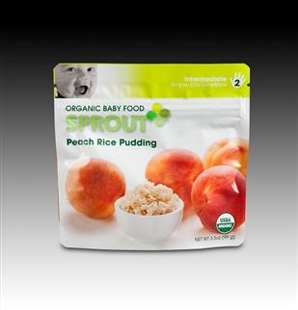
net weight/net volume
The actual weight or volume of food, excluding the weight of the container

Slide 15
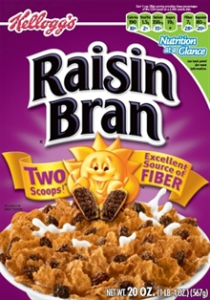
Manufacturer
The company that makes or produces the food product

Slide 16
Packer
The company that puts the food product into packages for retail selling

Slide 17
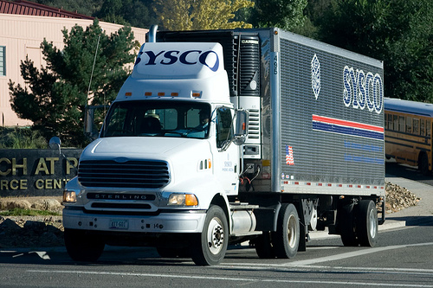
Distributor
The company that transfers the food product from manufacturer to seller

Slide 18
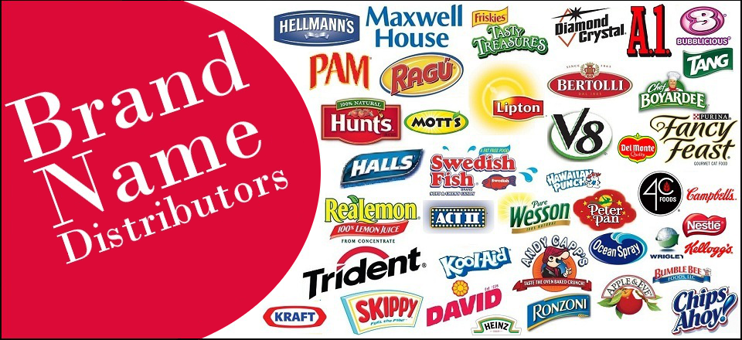
national brand
A well-known, nationally advertised trade name of product

Slide 19
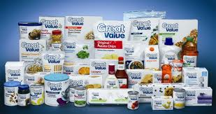
store brand
A store name used as the trade name of a product; only sold in one chain of stores

Slide 20
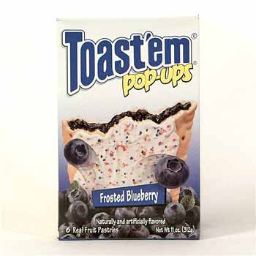
generic brand
A product that does not have a brand name

Slide 21
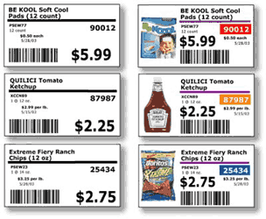
shelf tag
A label attached to the front edge of a store shelf containing price information

Slide 22
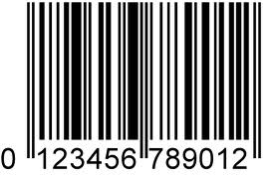
UPC
Universal Product Code; labeling containing price information read by scanning

Slide 23
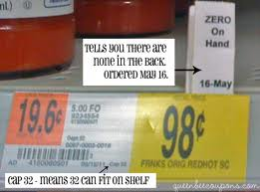
unit price
The cost per unit of measurement (ounce, pound, etc.) of a product

Slide 24
open dating
Labeling to show dates foods should be used for best quality, flavor, and appearance

Slide 25
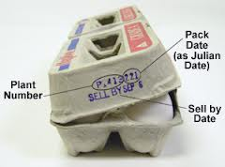
sell by/pull date
Last date a food product should be used

Slide 26
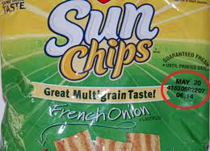
freshness date
Last date you can expect highest quality of a food product

Slide 27
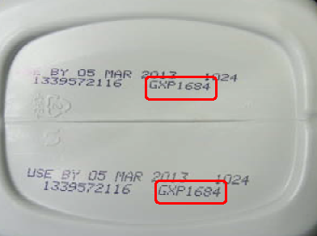
expiration date
Last date a food product should be used---e.g., yeast or baby formula

Slide 28
pack date
Date a food product was processed or packaged---e.g., with canned goods

Slide 29
Consumer information for apparel products

Slide 30
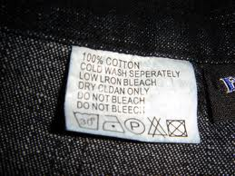
fiber name
The name of a thread/yarn used to make fabric for apparel or other textile products---e.g., cotton, wool, silk, linen, polyester, acrylic, acetate, nylon

Slide 31
content by weight
The percentage of total fiber in a textile product represented by one single fiber

Slide 32
country of origin
The nation in which the apparel product was made

Slide 33
care information
Recommended ways to launder, dry, iron, dry clean, etc.

Slide 34
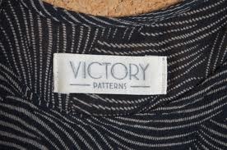
sewn-in label
A fabric label that has been permanently attached to an apparel product with stitches

Slide 35
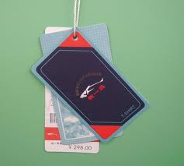
hang tag
A paper tag that has been temporarily attached to an apparel product

Slide 36
finish
A treatment that alters the performance of the fabric

Slide 37
stain-resistant
A finish that makes fabrics less likely to absorb and retain stains

Slide 38
Permanent press
A finish that makes fabrics less likely to wrinkle and retain wrinkles

Slide 39
fire-retardant
A finish that slows the spread of flames by burning slowly

Slide 40
Consumer information for personal hygiene products

Slide 41
personal hygiene drug
A product that claims to affect the structure of function of the body

Slide 42
personal hygiene cosmetic
A product that does not claim to affect the structure of function of the body

Slide 43
active ingredients
Elements in a product that make the product effective

Slide 44
“other” ingredients
Additional ingredients other than those that make the product effective

Slide 45
tamper-resistant
Packaged to make it clear whether the product has been opened since packaged

Slide 46
Jurisdiction
Authority, a right to

Slide 47
Reliability
Demonstrated or proven effectiveness

Slide 48

dermatologist-tested
Tried by a doctor specializing in healthy skin; proof of this not required by law

Slide 49

Hypoallergenic
Less likely to cause an allergic reaction; proof not required by law

Slide 50
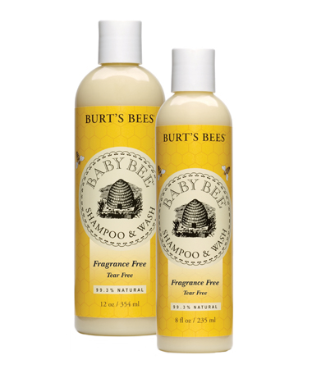
fragrance-free
Contains none or small amounts of fragrance ingredients; proof not required

Slide 51
Natural
Comes from a plant or animal source; proof not required by law

Slide 52
Noncomedogenic
Will not clog the pores; proof not required by law

Slide 53
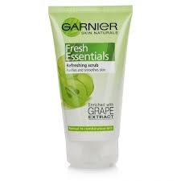
vitamin-enriched
Vitamins have been added to the product; proof not required by law

