Slide 1
Key Terms:
Shopping Options & Practices

Slide 2
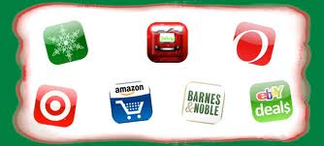
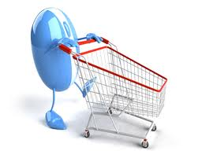
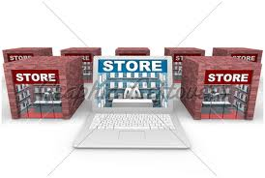
Shopping in Stores

Slide 3
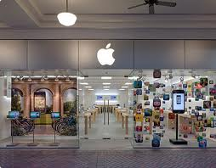
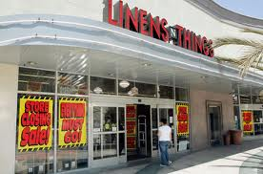
retail store
Obtains goods from wholesalers to sell to consumers

Slide 4
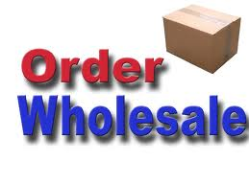
Wholesale
Obtains goods from suppliers to sell to retailers

Slide 5
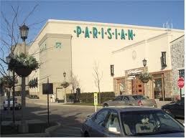
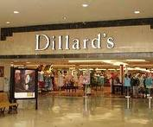
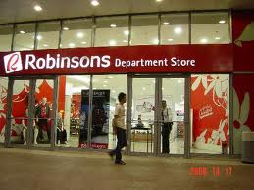
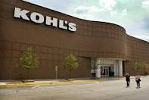
Department Store
Sells a variety of goods and services in a single store

Slide 6
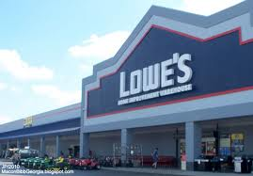
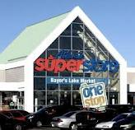
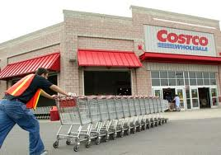
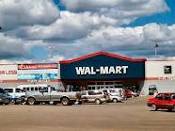
Warehouse Club and Super Store
Offers price advantages and wide product selection to its members

Slide 7
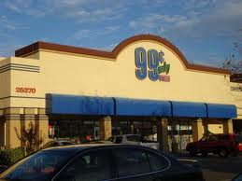
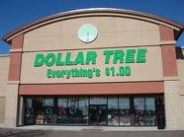
Discount Store
Sells certain lines of merchandise at below-average prices

Slide 8
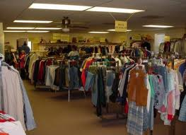
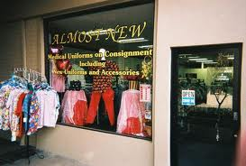
Consignment Store
Sells used merchandise at reduced prices

Slide 9
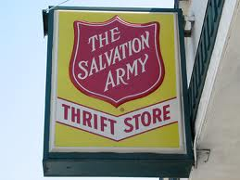
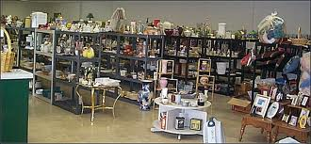
Thrift
The quality of being frugal, using resources wisely

Slide 10
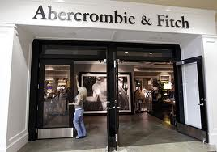
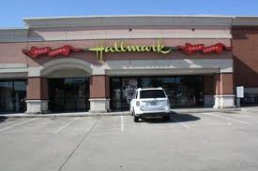
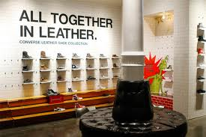
Specialty Store
Sell goods and services for specialized purposes

Slide 11
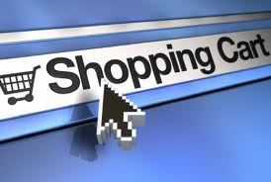
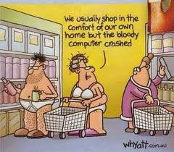
Shopping at Home

Slide 12
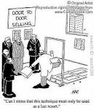
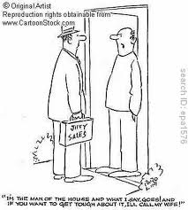
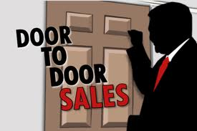
Door-to-door sales
Salesperson comes to home, either by invitation or not

Slide 13
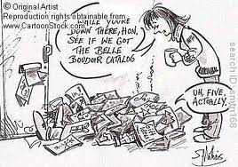
Catalog Shopping
Shopper calls on telephone to buy goods listed in a catalog

Slide 14
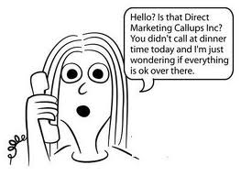
Telemarketing
Seller calls on telephone to sell goods or services

Slide 15
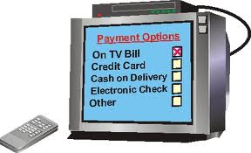
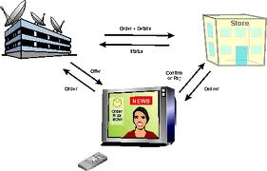
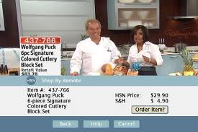
T-commerce
Shopping in response to ads on television

Slide 16
E-commerce
Buying goods and services on the Internet, including Internet auctions

Slide 17
Shopping Practices

Slide 18
Reliability
Being able to depend on a person or business to back up their claims

Slide 19
Services
Special consumer features offered by a store or other seller

Slide 20
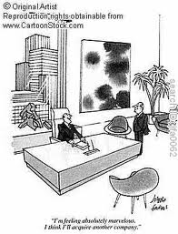
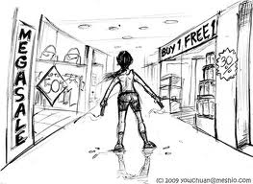
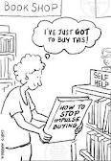
Impulse buying
Buying on the spur of the moment, without planning

Slide 21
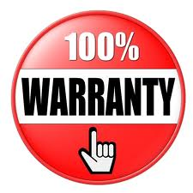
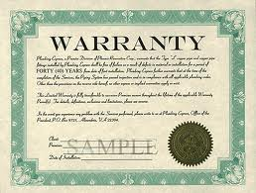
Warranty
A guarantee that a product will perform up to specified standards; four types are implied, written, full, and limited warranties

Slide 22
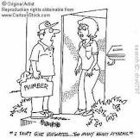
Estimate
A total expected cost, in writing, for performing a service

Slide 23
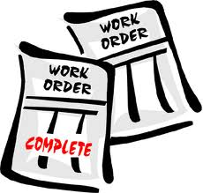
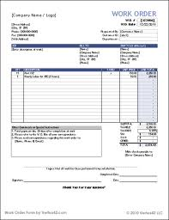
Work Order
Gives authority to a service provider to perform services

Slide 24
Contract
Legally binding papers signed by all parties in an agreement

Slide 25
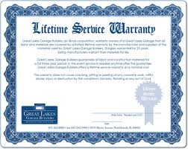
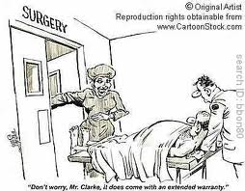
Service Warranty
Guarantees certain quality standards of performance

