Slide 1
6.02 Vocab
Personal Finance

Slide 2
public transit
Public modes of transportation available in cities---bus, subway, trolley

Slide 3

carpooling
Grouping with others to share rides to and from work

Slide 4

depreciate
To decrease in value

Slide 5
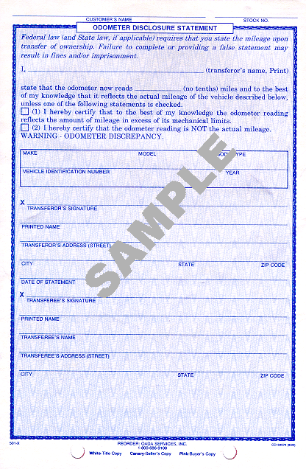
disclosure sheet
Describes any repairs or replacements done on a used care

Slide 6



Make
The brand of a vehicle

Slide 7

Model
A line of vehicles made by a specific company, such as Ford Taurus

Slide 8

domestic
American-made

Slide 9


imported
Foreign-made

Slide 10
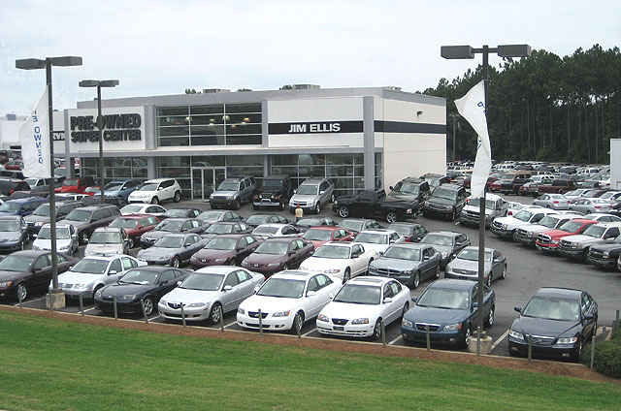
auto superstore
Dealerships with huge inventories of new and used vehicles

Slide 11
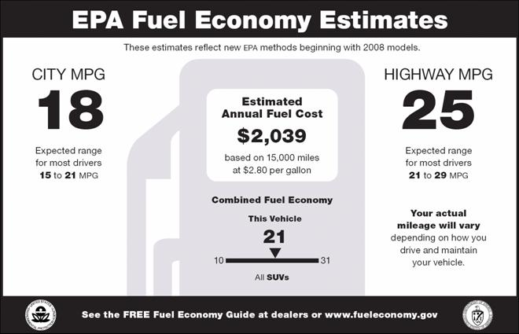
fuel economy
Type of fuel used and miles per gallon

Slide 12

Power
A vehicle’s ability to accelerate for speed

Slide 13

performance
A vehicle’s ability to handle, brake, and accelerate on the road

Slide 14
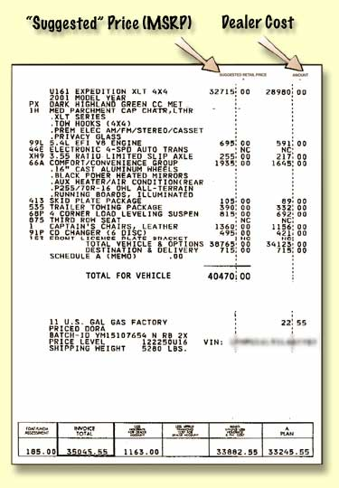
invoice price
The price the dealer pays the manufacturer

Slide 15
base price
The price of a vehicle with standard equipment

Slide 16
Options
features available at extra cost or special prices

Slide 17
manufacturer’s suggested retail price
Base price + price options installed by manufacturer + manufacturer’s transportation charge

Slide 18
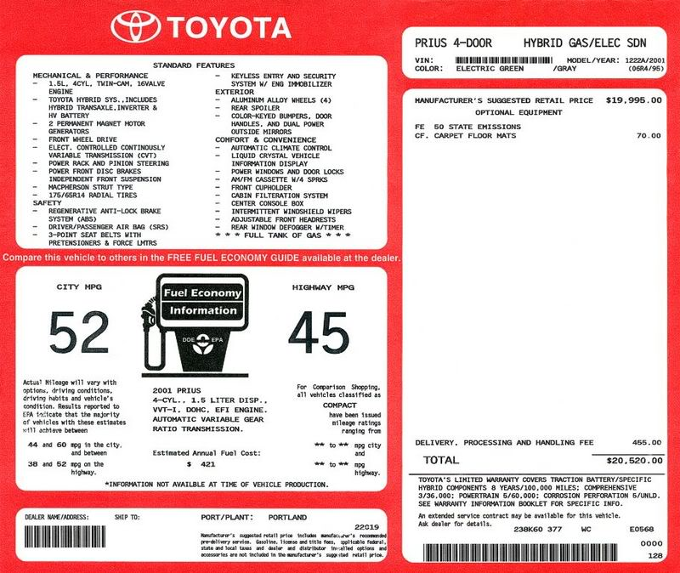
sticker price
Dealer’s initial asking
price as found on the
sticker in the vehicle
window.

Slide 19
up front costs
Costs when signing a lease---deposit, taxes, and registration fees

Slide 20
Leasing
Monthly payments in exchange for exclusive use of vehicle for a time

Slide 21
capitalized cost
Price for a leased care

Slide 22
capitalized cost reduction
Payment similar to down payment that results in lower monthly payment

Slide 23
lease term
Length of the lease---usually, 24, 36, or 48 months

Slide 24
option to purchase
At end of lease, the alternative to purchase the leased vehicle

Slide 25
residual value
The worth of a leased vehicle at the end of the lease

Slide 26
installment loan
A loan to be repaid in equal payments

