Slide 1
Desktop Publishing Documents

Slide 2
Logos
a graphic representation or symbol of a company name, trademark, abbreviation, etc., often uniquely designed for ready recognition.

Slide 3
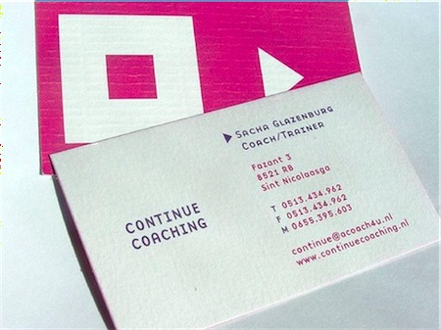
Business Card
A small card on which is printed, typically, a person's name, job title, firm, business address, and telephone number.
Email, Fax, or Logo maybe included.

Slide 4
Letterhead
A printed heading on stationery, especially one giving the name and address of a business concern, an institution, etc.
May also have the logo and watermark.

Slide 5
Flyer
An advertisement (usually printed on a page or in a leaflet) intended for wide distribution.
Includes all or some of these: Logo, graphics, slogan, event or business information such as name, address, location, business hours, or time of event, and basic information about the event.

Slide 6
Flyer Example

Slide 7
Newspaper / Magazine Ad
A short advertisement in a newspaper or magazine.
Would include: Short business description or slogan with picture or logo if part of the advertising package.

Slide 8
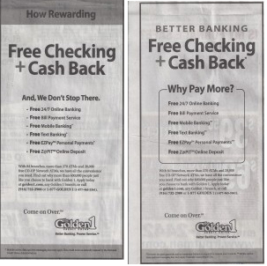
Examples of Newspaper Ads

Slide 9
Brochure
A booklet or pamphlet that contains descriptive information or advertising.
Would include: Logo, graphics, detailed information about an event or business, address, business hours or event hours, etc.

Slide 10
Example of Brochure

