Slide 1
Key Terms: 5.01
Consumer Rights and Responsibilities

Slide 2


Good
A physical object that is purchased

Slide 3
Service
An action that is performed for someone’s benefit
Examples: car repair, hair cut, internet connection, cell phone connection

Slide 4
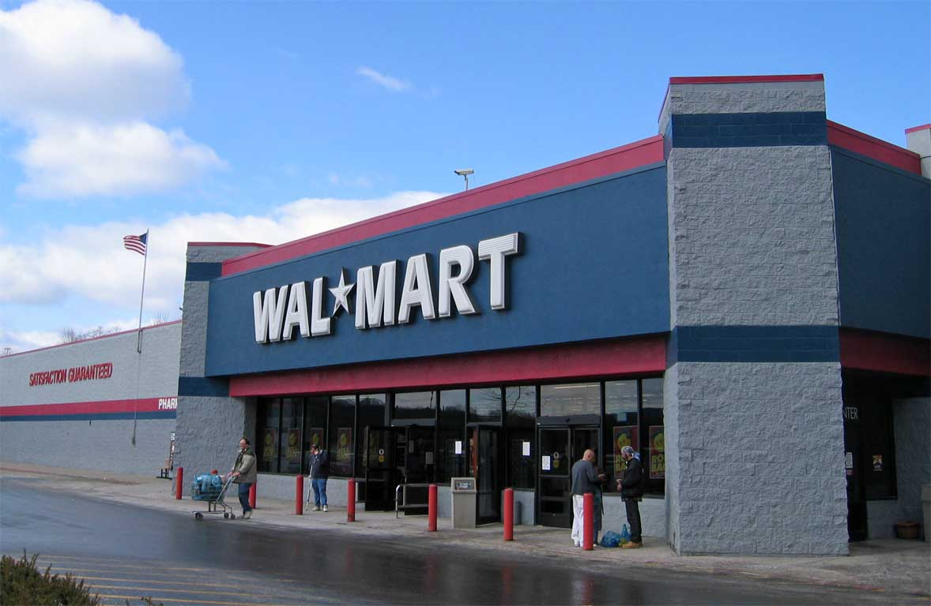
Retailer
One who sells goods and services directly to consumers

Slide 5
Marketplace
All retailers’ goods and services available to the general public

Slide 6
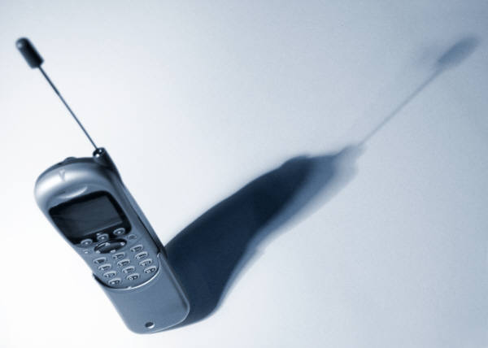

Merchandise
A product or physical item purchased
Examples: clothes, video games, music discs, computer, cell phone

Slide 7
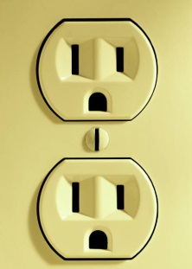
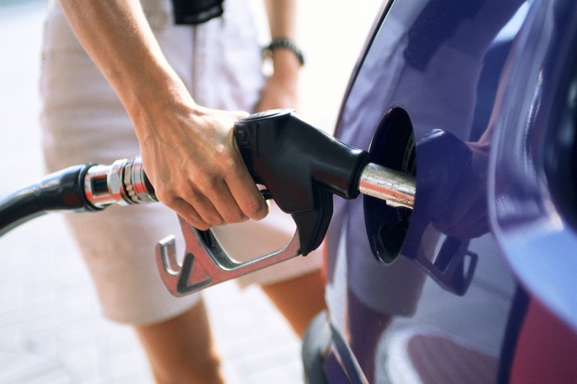
Consumable Product
A product that typically provides a single use or period of use and is destroyed or disappears as the consumer enjoys the product
Examples: food, cell phone monthly service minutes, electricity, and gasoline

Slide 8

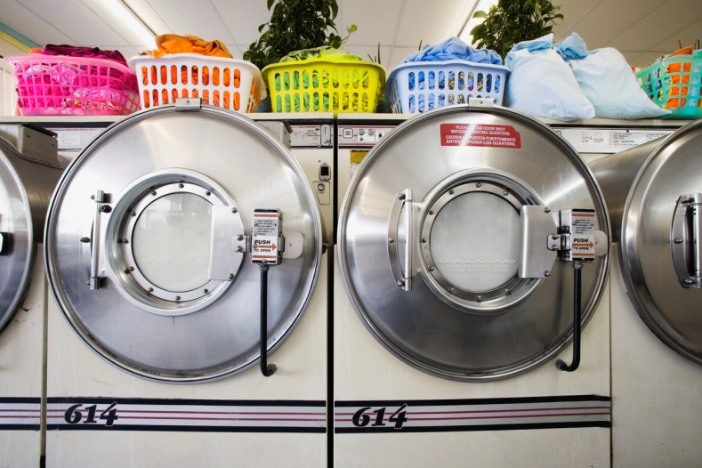
Durable Product
A product that lasts for a long period of time and continues to be available to the consumer for more than a single use.
Examples: cars, washing machines, computers, cell phone

Slide 9
Warranty
A guarantee that a product is in good working order and will give good service for a reasonable amount of time. A full warranty has no specific limitations while a limited warranty does and must state what the limitations are.
For example, a used car warranty might state that the dealer would be responsible for repairs on certain types of parts and equipment for a specified timeframe. Consumers would be responsible for paying for other repairs not covered under the warranty.

Slide 10


Government Agency
An organization that operates as part of the state or federal government

Slide 11

Merchant Services
Any helps provided to consumers by companies/stores/businesses

Slide 12

Consumer Affairs Department
A department of a business that communicates with customers about their rights and needs as consumers

Slide 13
Consumer Advocate
A person or organization that works on behalf of consumers’ interests and rights

Slide 14

Better Business Bureau (BBB)
A nonprofit organization sponsored by private businesses that attempts to settle consumer complaints against local businesses

Slide 15
Consumer Action Panel
A group formed by a trade association to address consumer complaints

Slide 16
Right to be Safe
Being entitled to protection against potentially harmful goods and services

Slide 17
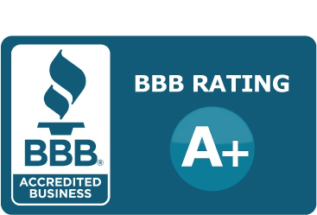
Right to be Informed
Being entitled to information about a seller’s reputation, product and service performance, quality, and price

Slide 18
Right to choose products and services
Having the opportunity to select goods, services, and places to shop

Slide 19


Competition
A situation in which the same or similar goods and services are offered by more than one seller.

Slide 20
Right to be heard
Having opportunities to make known likes, dislikes, and problems with products and services

Slide 21
Right to redress
Being entitled to a fair and quick remedy to a wrong or loss

Slide 22
Right to consumer education
Being entitled to training to gain knowledge and skills as consumers

Slide 23
Right to service
Being entitled to convenience, courtesy, and responsiveness

Slide 24
Right to a healthy environment
Being able to live in a safe, non-threatening environment

Slide 25
Consumer Responsibilities
Types of activities a consumer is expected to perform as part of a purchase decision

Slide 26
To use products safely
Read and follow manufacturers’ directions for using a product

Slide 27
To find and use information
Find materials to compare sellers and products/services to be purchased

Slide 28
To choose purchases carefully
Make purchases from companies with reliable products and ethical business practices

Slide 29
To speak up
Let companies know when products/services are defective or below-standard

Slide 30
To seek redress
Pursue remedies whenever products/services do not meet expectations

Slide 31
To learn
Learn skills that prepare one to be a confident, informed consumer

Slide 32
To reward good service
Use your buying power to support reliable sellers and service providers

Slide 33
To promote a healthy caring relationship with the environment
Consider the effect on the environment of consumer practices, and support companies that consider the environment as well

